Slide 1

C# Fundamentals
Course Introduction
SoftUni Team
Technical Trainers
Software University
https://softuni.bg/

Slide 2
Table of Contents
Course Objectives
Training and Team
Course Organization
Course Infrastructure
Evaluation Criteria

Slide 3
Have a Question?
sli.do
#fund-csharp

Slide 4














SoftUni Diamond Partners

Slide 5

Educational Partners

Slide 6

Course Objectives

Slide 7
C# Fundamentals Objectives
Working with linear data structures
Arrays and Lists
Defining simple classes
Processing and manipulating strings
Regular expressions
Building а simple web project

Slide 8
Practical Programming Exam
Mid Exam
3 practical problems for 4 hours
Conditional Statements and Loops
Arrays
Lists
Final Exam
3 practical problems for 4 hours
Associative Arrays
Strings and Text Processing
Regular Expressions

Slide 9
Theoretical Exam
You will have 30 minutes once you start
Multiple choice with 1 or more correct answers
English
Automated quiz system
Available during the practical exam and 30 minutes after it
You can submit your answers just one time
Advice: Start it when you finish the practical exam

Slide 10

Course Organization

Slide 11
C# Fundamentals Module
9-Jan-2023
19-Feb-2023
2-Apr-2023
6-Apr-2023
10-Apr-2023
C# Fundamentals
12 weeks * 3 times / week 12 credits
Start: 9-Jan-2023
Mid Exam: 19-Feb-2023
Theoretical Exam: 2-Apr-2023
Final exam: 2-Apr-2023
Retake Exams
Mid Exam Retake: 6-Apr-2023
Тheoretical Exam: 10-Apr-2023
Final Exam Retake : 10-Apr-2023

Slide 12
Course Scoring
Practice grade:
Theory grade:
SoftUni Certificate: 5.00 from Practice
CPE Certificate: 3.00 average from Practice + Theory
Practical Mid Exam
Practical Final Exam
Homework
40 %
60 %
+5 %
Theoretical Exam
100 %
12

Slide 13

Homework Assignments & Exercises
Your homework is mainly work in class
Lesson days → slides + live demos + exercises
Exercise days → only exercises
How to submit your homework?
Submitted in the judge system
Do your homework when it's due
Assignments pile up quickly

Slide 14


Learn to Search in Internet
The course assignments require to search in Internet
This is an important part of the learning process
Some exercises intentionally have no hints
Learn to find solutions!
Software development includes everyday searching and learning
No excuses, just learn to study!
Developers learn new technologies, tools, languages every day!

Slide 15

The Team

Slide 16
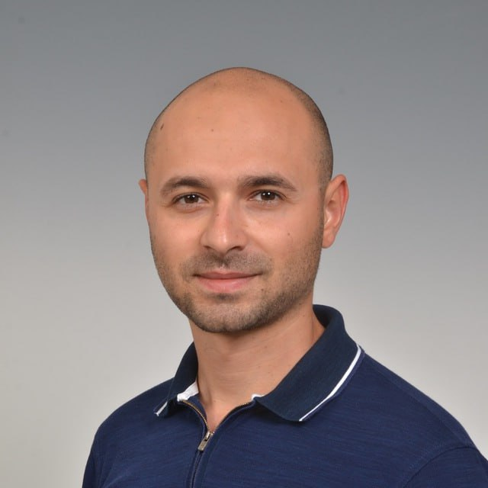
Stoyan Shopov
Senior Software Engineer @ Grand Games
Technical Тrainer @ SoftUni ~5 years
Microsoft Certified Trainer & Public Speaker
Experience with ASP.NET, Azure,
Unity and others

Slide 17
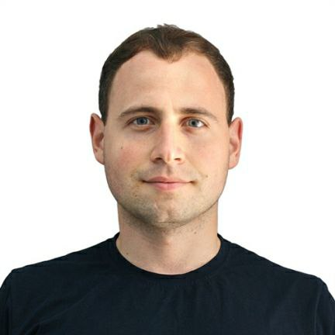
Dean Milanov
Studied Software Engineering @ FMI (SU)
Team Lead @ OSI with focus on improving
web apps performance
Interests include .NET & SQL
Programming experience since high school
Experience in various projects in healthcare, finance & trading

Slide 18



Course Web Site, Forum and FB Group
Official web site:
Official discussion forum:
C# Fundamentals Facebook group:
https://softuni.bg/trainings/3949/programming-fundamentals-january-2023
https://softuni.bg/forum/categories/783/csharp-fundamentals
https://www.facebook.com/groups/ProgrammingFundamentalswithCsharpJanuary2023

Slide 19
Questions?
Notes:
19

Slide 20
Trainings @ Software University (SoftUni)
Software University – High-Quality Education, Profession and Job for Software Developers
softuni.bg, about.softuni.bg
Software University Foundation
softuni.foundation
Software University @ Facebook
facebook.com/SoftwareUniversity
Software University Forums
forum.softuni.bg
Notes:
20

Slide 21

License
This course (slides, examples, demos, exercises, homework, documents, videos and other assets) is copyrighted content
Unauthorized copy, reproduction or use is illegal
© SoftUni – https://about.softuni.bg/
© Software University – https://softuni.bg
Notes:
21

